Slide 2
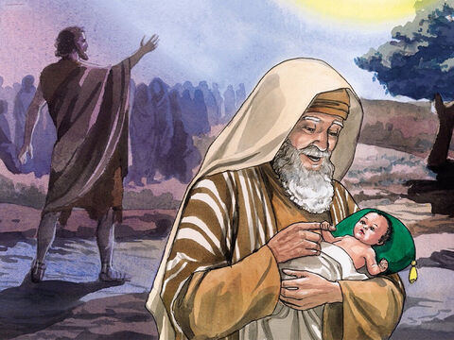
Life Of John

Slide 3
Promised To Godly Parents
3
Luke 1:6 “they were both righteous before God”
Luke 1:13 “your wife Elizabeth will bear you a son, and you shall call his name John.”
Like 1:60 “he shall be called John.”
Luke 1:63 “His name is John.”
“Baptist” was not part of his name!
Called “THE BAPTIST” because of what he did

Slide 4
John Was Given A Specific Mission
John’s Work Prophesied – Isaiah 40:3-5 “Prepare the way of the Lord;”
Malachi 3:1 “And he will prepare the way before Me.”
Malachi 4:5,6 “5 Behold, I will send you Elijah the prophet Before the coming of the great and dreadful day of the Lord. 6 And he will turn The hearts of the fathers to the children, And the hearts of the children to their fathers,”

Slide 5
Important To Understand His Mission
5
Christ said He would build His church – Matthew 16:18
Christ purchased the church with His Blood – Acts 20:28
The church is called His body – Christ is the head – Ephesians 1:22,23
The Mission of John-
Prepare the way of the Lord – John 1:23; Matthew 15:7-9

Slide 6
John’s 2nd Mission to Bear Witness
John 1:32-34 “John bore witness…And I have seen and testified that this is the Son of God.”
John 3:26-30 “He must increase, but I must decrease.”
John 1:36,37 “Behold the Lamb of God!”

Slide 7
John’s 3rd Duty- Turn Hearts Back To God
7
Luke 1:16 “And he will turn many of the children of Israel to the Lord their God.”
Luke 1:17 “17 “He will also go before Him in the spirit and power of Elijah,”
Malachi 4:6 “turn the hearts of the fathers to the children,”
Spiritual Decay – 2 Timothy 3:2,3 “without natural affection”

Slide 8
John’s 4th Part To Warn Disobedient
Luke 1:17 “the disobedient to the wisdom of the just”
John did not come to build the church – Matthew 14:1-12 “he sent and had John beheaded in prison”
Basing a Church on John would be fatal –he lived and died prior to the establishment of the N.T. church

Slide 9
JOHN’S MESSAGE:
9
Repentance – Matthew 3:1,2 “Repent, for the kingdom of heaven is at hand!”
Matthew/Luke 3:8 “bear fruits worthy of repentance.”
Of Wrath To Come – Matthew 3:7; Romans 2:5; Galatians 6:7,8
Preached That Christ Would Baptize With Fire – Matthew 3:12 “burn up the chaff with unquenchable fire.”
Christ Would Baptize With The Holy Spirit – Matthew 3:11; Acts 1:4,5

Slide 10
JOHN’S MESSAGE:
10
Kingdom of Heaven At Hand – Matthew 3:1,2
Not set up in days of Abraham or Moses
Not in existence at that time
Not to exist in a “thousand years” in the future
It WAS drawing near to the time
John was preaching in the 4th kingdom of Daniel 2:44
Not long after his passing the Kingdom was established

Slide 11
JOHN’S MESSAGE:
11
Baptism of Repentance For The Remission Of Sins
Mark 1:4; Luke 3:3 “preaching a baptism of repentance for the remission of sins.”
Looked forward to death of Christ – not in the name of Christ
Matthew 28:19 “ baptizing them in the name of the Father and of the Son and of the Holy Spirit.”
It was temporary – Acts 19:1-5 “they were baptized in the name of the Lord Jesus.”
Baptism into Christ goes on – Matthew 28:20

Slide 12
JOHN’S MESSAGE:
12
Baptism of Repentance For The Remission Of Sins
Required confession of sins – baptism into Christ requires confession of Faith in Christ- Romans 10:9
Did not put one into Christ – Galatians 3:27
Did not put one into the church- 1 Corinthians 12:13; Ephesians 1:22,23

Slide 13
IT IS ESSENTIAL THAT WE SEE
That John Did Not Preach Or Teach What Baptists Today Claim To Be His Doctrine!

Slide 14
Can I Neglect So Great A Salvation [Hebrews 2:2-4]
14
Based Upon The Error Of Man’s Ways
Or Will I Submit To Christ Today And Become An Heir Of Salvation?

